Slide 1
School of Computing Science and Engineering
Course Code: BCSE2350 Course Name: Cryptographic Fundamental
Introduction to security and encryption techniques

Slide 2
Contents
Introduction to security
Introduction to encryption techniques
Conventional Encryption model
classical encryption techniques
substitution ciphers

Slide 3
Introduction to security
Information Security requirements have changed in recent times
traditionally provided by physical and administrative mechanisms
computer use requires automated tools to protect files and other stored information
use of networks and communications links requires measures to protect data during transmission

Slide 4
Definitions
Computer Security - generic name for the collection of tools designed to protect data and to thwart hackers
Network Security - measures to protect data during their transmission
Internet Security - measures to protect data during their transmission over a collection of interconnected networks

Slide 5
Aim of Course
our focus is on Internet Security
consists of measures to deter, prevent, detect, and correct security violations that involve the transmission of information

Slide 6
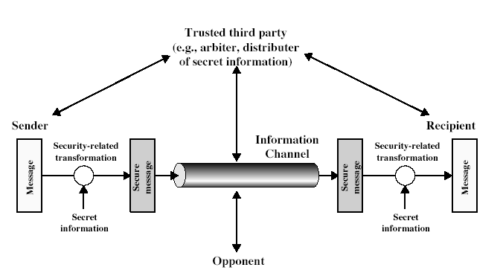
Model for Network Security

Slide 7
Introduction to encryption techniques
What is Cryptography?
“Hidden Writing”
Mainly used to protect Information.

Slide 8
NEED OF ENCRYPTION
Confidentiality
Integrity
Authentication
Nonrepudiation
Access Control
Availability

Slide 9
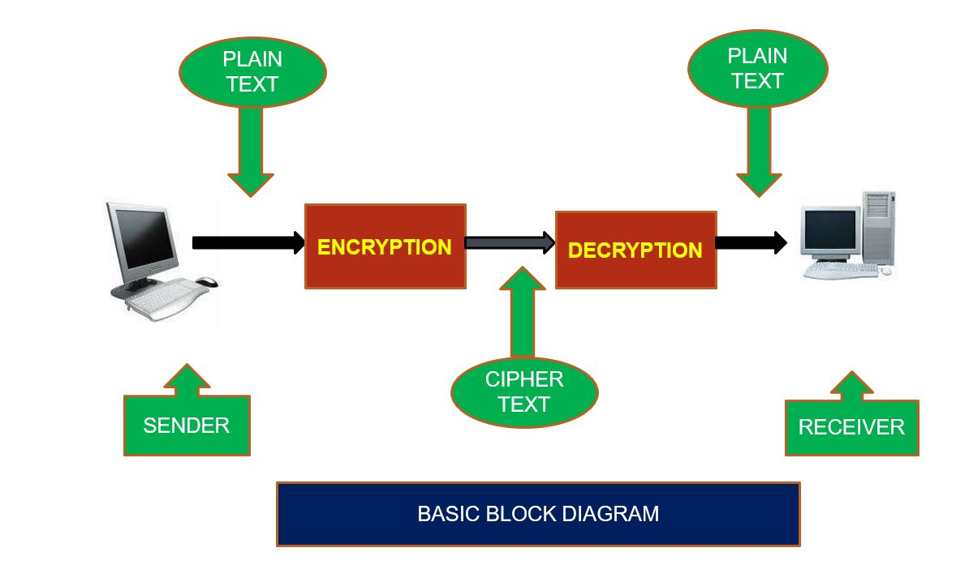
Block Diagram

Slide 10
BASIC TERMINOLOGIES
Encryption
Encryption is the process of encoding a message so that its meaning is not obvious
Decryption
Decryption is the reverse process, transforming an encrypted message back into its normal, original form
Cryptosystem
A system for encryption and decryption is called a cryptosystem.

Slide 11

BASIC TERMINOLOGIES
Plaintext
Cipher text
Key –
key refers to a sequence of symbols or a numerical value used by an algorithm to alter information & making that information secure
Encryption algorithm
The cryptosystem involves a set of rules for how to encrypt the plaintext and how to decrypt the cipher text.
Cryptanalysis
Cryptanalysis is an attempt to break the cipher text.

Slide 12
TECHNIQUES OF CRYPTOGRAPHY
Substitution Technique
Caesar Cipher
Monoalphabetic Cipher
Playfair Cipher
Polyalphabetic Cipher
Transposition Technique
Rail Fence Technique
Vernam Cipher(One -time Pads)
Simple Columnar Cipher

Slide 13
ENCRYPTION ALGORITHM
Symmetric
Same key for encryption and decryption
Key distribution problem
Asymmetric
Key pairs for encryption and decryption
Public and private keys

Slide 14
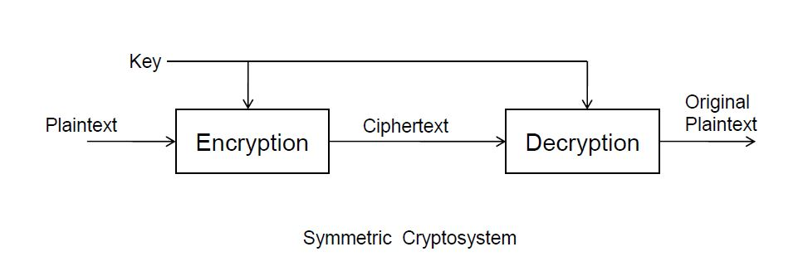
SYMMETRIC ALGORITHM
It is also called as Secret Key Cryptography
Single key used for both encrypt & decrypt
Key must be known to both the parties

Slide 15
ASYMMETRIC ALGORITHM
Private keys are used for decrypting.
Public keys are used for encrypting
encryption
plaintext
ciphertext
public key
decryption
ciphertext
plaintext
private key

